Slide 1
Computing information criteria for multilevel models using different sample sizes
Wendy Christensen
University of California, Los Angeles

Slide 2
School 1
School 2
S1
S2
S3
S4
S5
S6

Slide 3
School 1
School 2
N = 6
S1
S2
S3
S4
S5
S6

Slide 4
School 1
School 2
m = 2
N = 6
S1
S2
S3
S4
S5
S6

Slide 5
Model selection using information criteria
1
Model 1
Model 2
Model 3

Slide 6
Model selection using information criteria
1
Model 1
Model 2
Model 3
2
Deviance 1
Deviance 2
Deviance 3

Slide 7
Model selection using information criteria
1
Model 1
Model 2
Model 3
2
Deviance 1
Deviance 2
Deviance 3
3
I.C. 1
I.C. 2
I.C. 3

Slide 8
Model selection using information criteria
1
Model 1
Model 2
Model 3
2
Deviance 1
Deviance 2
Deviance 3
3
I.C. 1
I.C. 2
I.C. 3
4
Smallest I.C. value = “best” model

Slide 9
Choice of sample size matters!
AIC BIC
Deviance + 2*k Deviance + log(N)*k

Slide 10
Choice of sample size matters!
AIC BIC
Deviance + 2*k Deviance + log(N)*k
Model deviance

Slide 11
Choice of sample size matters!
AIC BIC
Deviance + 2*k Deviance + log(N)*k
Model deviance
Number of model parameters

Slide 12
Choice of sample size matters!
AIC BIC
Deviance + 2*k Deviance + log(N)*k
Model deviance
Number of model parameters
Sample size: m or N?

Slide 13
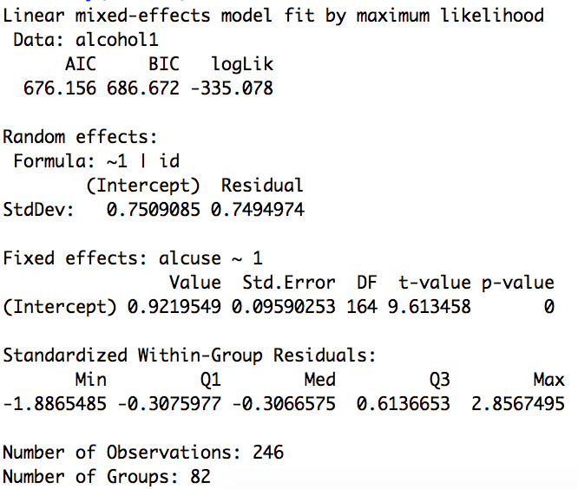
Example using the nlme package^{[1][2]}
Information criteria
Parameters
N
m
[1] Singer & Willett (2003): Applied Longitudinal Data Analysis
[2] UCLA Statistical Consulting Group: https://stats.idre.ucla.edu/r/examples/alda/r-applied-longitudinal-data-analysis-ch-4/

Slide 14
Computing BIC using m (number of clusters)
str(model)
logLikelihood <- model$logLik
deviance <- -2*logLikelihood
groups <- head(model$dims$ngrps,n=1)
m <- unname(groups, force = FALSE)
N <- model$dims$N
BIC_m <- deviance+log(m)*3
BIC_N <- deviance+log(N)*3
Examine to find necessary elements from output

Slide 15
Computing BIC using m (number of clusters)
str(model)
logLikelihood <- model$logLik
deviance <- -2*logLikelihood
groups <- head(model$dims$ngrps,n=1)
m <- unname(groups, force = FALSE)
N <- model$dims$N
BIC_m <- deviance+log(m)*3
BIC_N <- deviance+log(N)*3
Isolate model log-likelihood
Compute model deviance

Slide 16
Computing BIC using m (number of clusters)
str(model)
logLikelihood <- model$logLik
deviance <- -2*logLikelihood
groups <- head(model$dims$ngrps,n=1)
m <- unname(groups, force = FALSE)
N <- model$dims$N
BIC_m <- deviance+log(m)*3
BIC_N <- deviance+log(N)*3
Obtain number of clusters

Slide 17
Computing BIC using m (number of clusters)
str(model)
logLikelihood <- model$logLik
deviance <- -2*logLikelihood
groups <- head(model$dims$ngrps,n=1)
m <- unname(groups, force = FALSE)
N <- model$dims$N
BIC_m <- deviance+log(m)*3
BIC_N <- deviance+log(N)*3
Compute BIC(m)
683.376

Slide 18

Computing BIC using N (total observations)
str(model)
logLikelihood <- model$logLik
deviance <- -2*logLikelihood
groups <- head(model$dims$ngrps,n=1)
m <- unname(groups, force = FALSE)
N <- model$dims$N
BIC_m <- deviance+log(m)*3
BIC_N <- deviance+log(N)*3
Matches output!
686.6719…

Slide 19
Thanks!
Wendy Christensen
wchristensen@ucla.edu
Code available at: https://github.com/wendychristensen

